Slide 1
Abstract & interface

Slide 2
Abstract Classes
An abstract class is a placeholder in a class hierarchy that represents a generic concept
An abstract class cannot be instantiated
We use the modifier abstract on the class header to declare a class as abstract:
public abstract class Whatever
{
// contents
}

Slide 3
Abstract Classes
An abstract class often contains abstract methods with no definitions (like an interface does)
Unlike an interface, the abstract modifier must be applied to each abstract method
An abstract class typically contains non-abstract methods (with bodies), further distinguishing abstract classes from interfaces
A class declared as abstract does not need to contain abstract methods

Slide 4
Abstract Classes
The child of an abstract class must override the abstract methods of the parent, or it too will be considered abstract
An abstract method cannot be defined as final (because it must be overridden) or static (because it has no definition yet)
The use of abstract classes is a design decision – it helps us establish common elements in a class that is too general to instantiate

Slide 6
Data Abstraction or Data Hiding
It hides the detailed implementation of an object from user.
The process of extracting the essential information and hiding the irrelevant details to avoid complexity.
Example: Money withdraw from ATM

Slide 7


Slide 8
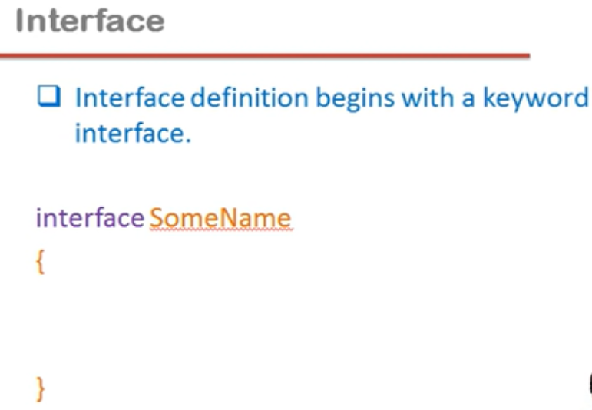

Slide 9

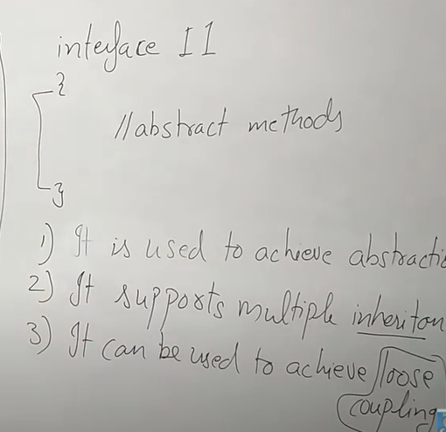

Slide 10


Slide 11
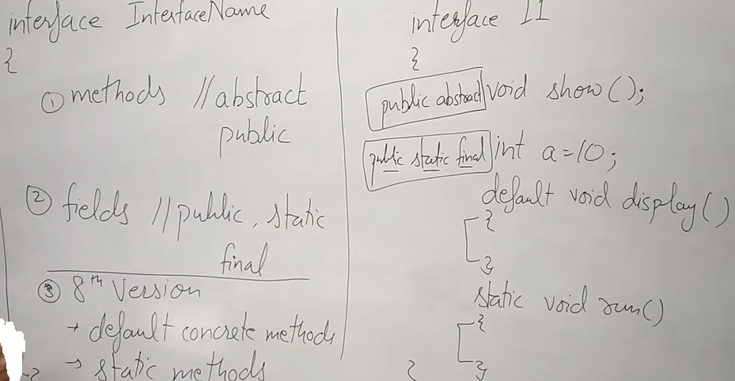

Slide 12
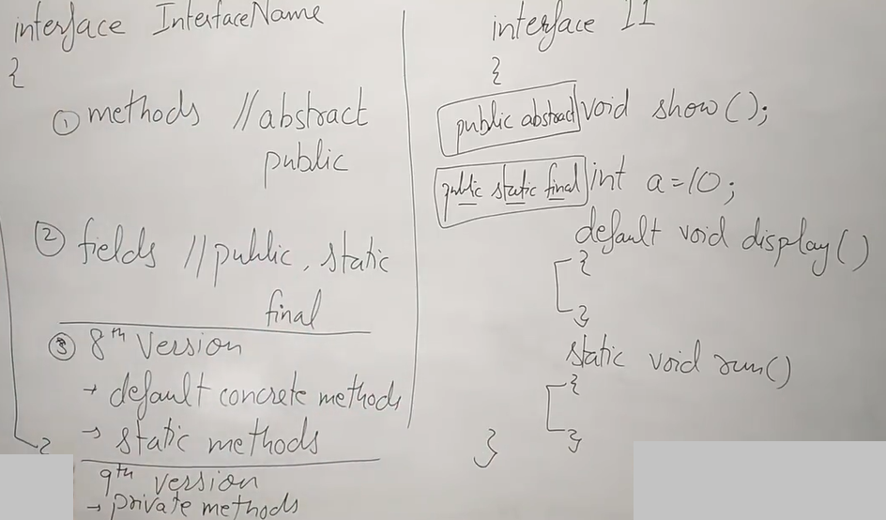

Slide 13
Interface in java
An interface in the Java programming language is an abstract type that is used to specify a behavior that classes must implement.

Slide 14
An interface is an abstract type that is used to specify a behavior that classes must implement. They are similar to protocols.
Interfaces are declared using the interface keyword, and may only contain method signature and constant declarations (variable declarations that are declared to be both static and final).

Slide 15
All methods of an Interface do not contain implementation (method bodies) as of all versions below Java 8.
Starting with Java 8, default and static methods may have implementation in the interface definition.
Then, in Java 9, private and static methods were added. At present, a Java interface can have up to six different types.

Slide 16
Interfaces cannot be instantiated, but rather are implemented.
A class that implements an interface must implement all of the non-default methods described in the interface, or be an abstract class.
Object references in Java may be specified to be of an interface type; in each case, they must either be null, or be bound to an object that implements the interface.

Slide 17
One benefit of using interfaces is that they simulate multiple inheritance.
All classes in Java must have exactly one base class, the only exception being java.lang.Object (the root class of the Java type system); multiple inheritance of classes is not allowed.
However, an interface may inherit multiple interfaces and a class may implement multiple interfaces.

Slide 18
An interface:
declares only method headers and public constants.
cannot be instantiated.
can be implemented by a class.
cannot extend a class.
can extend several other interfaces.

Slide 19
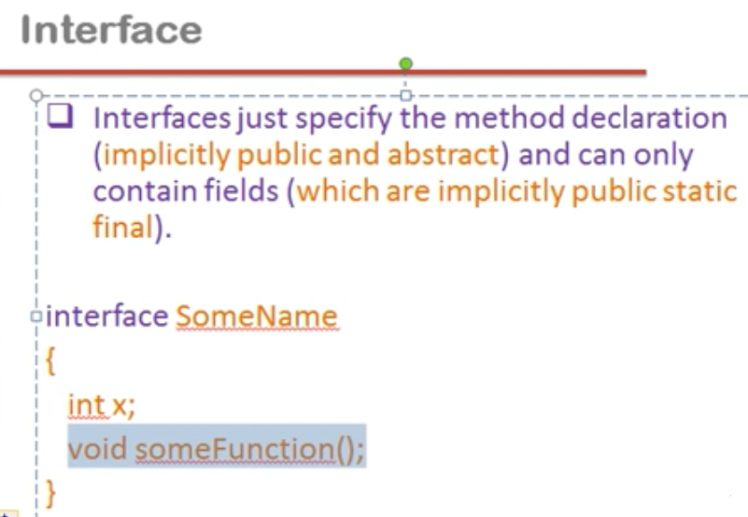

Slide 20
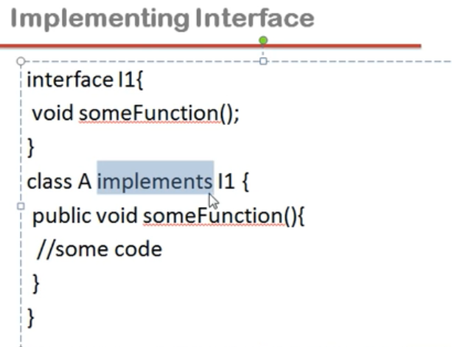

Slide 21
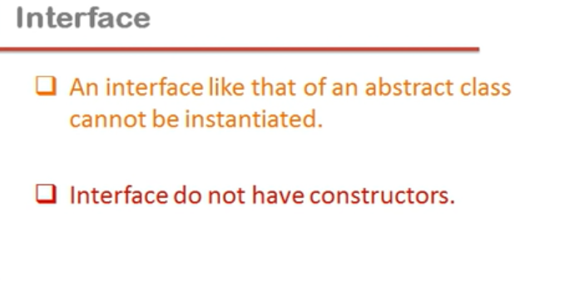

Slide 22
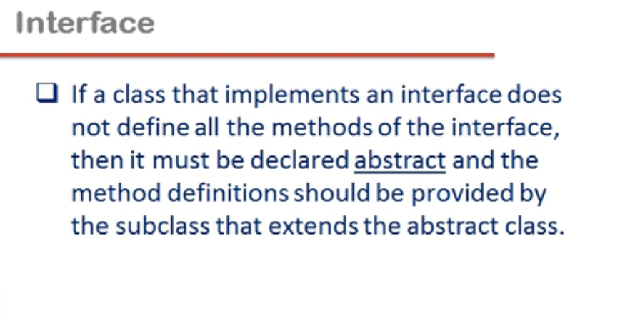

Slide 23
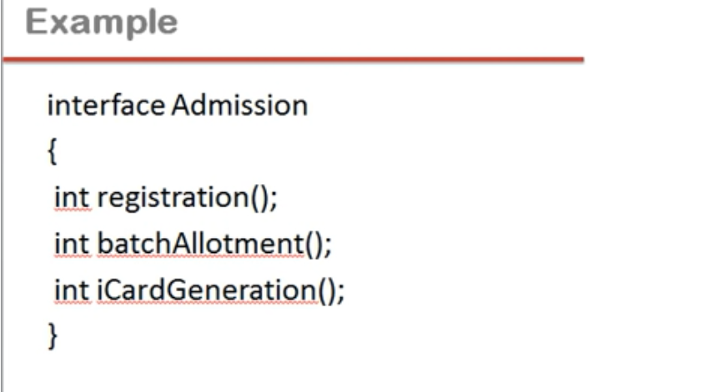

Slide 24
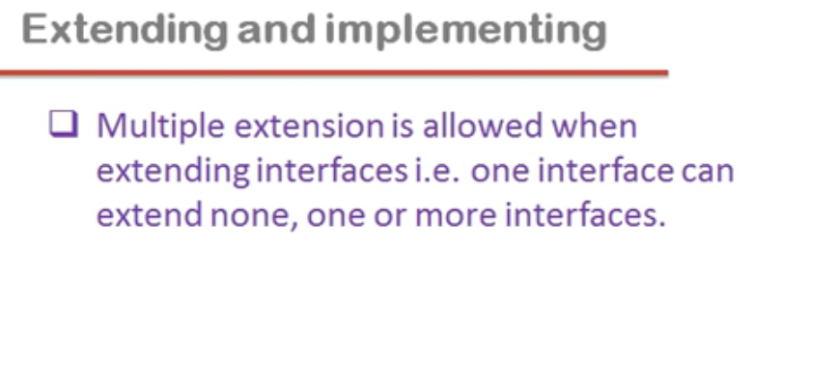

Slide 25
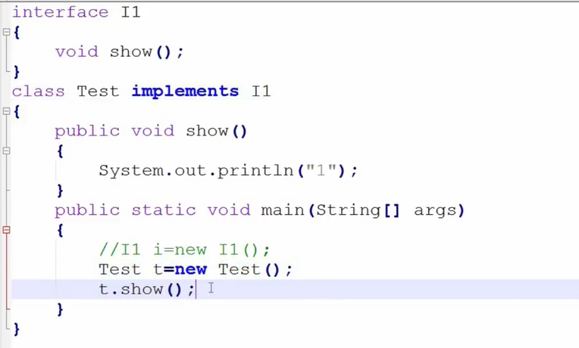

Slide 26
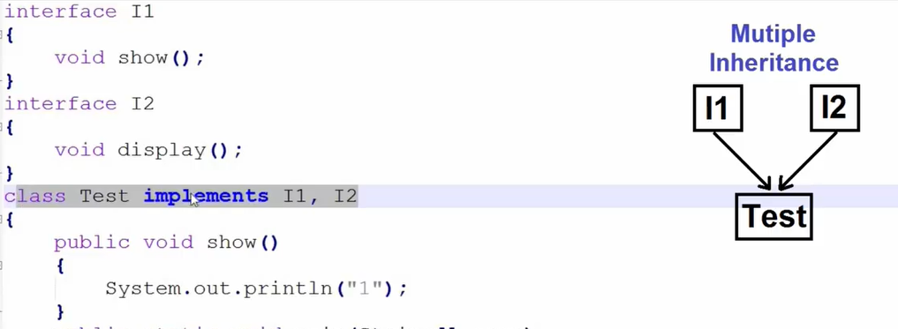

Slide 27
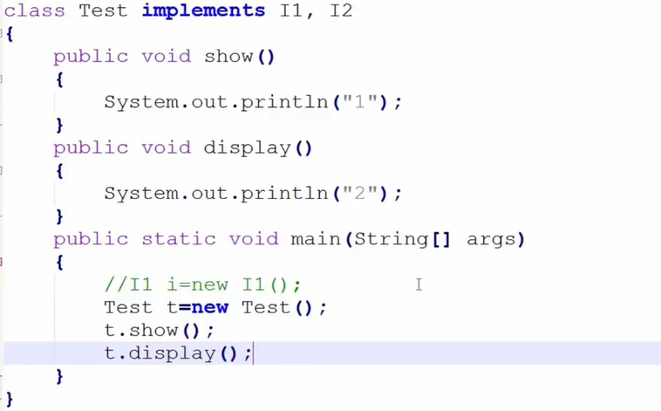

Slide 28


Slide 29
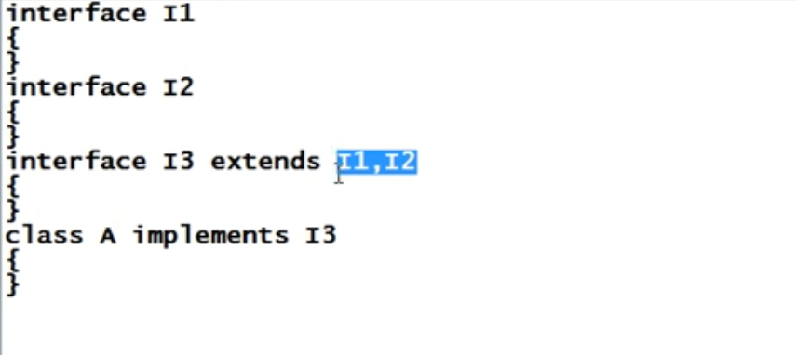

Slide 30
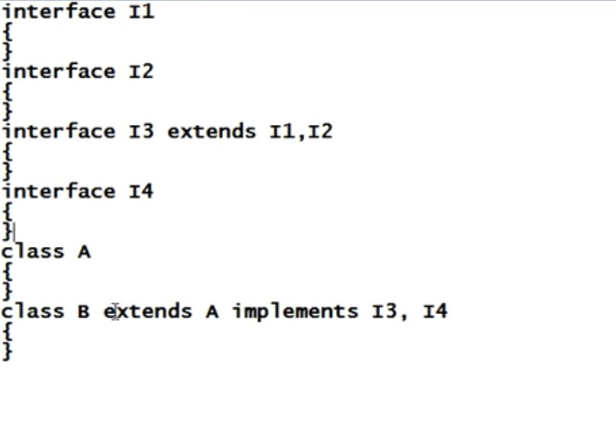

Slide 31
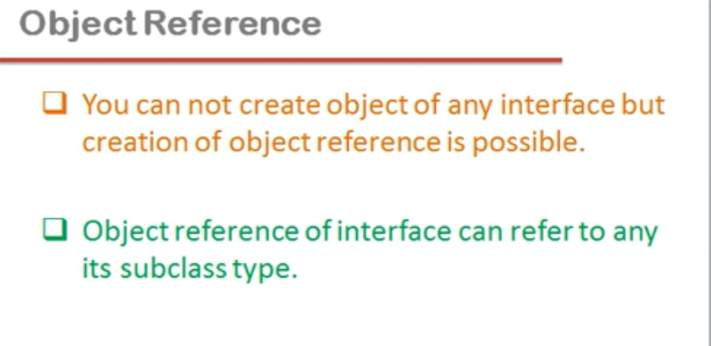

Slide 32
